Slide 1
SUMMER INTERNSHIP REVIEW
Diabetes Prediction Using Machine Learning
Presented by:
23A91A61E7 –D .SAI NANDITHA– AIML

Slide 2
PROBLEM STATEMENT:
Diabetes is a chronic disease that affects millions worldwide.
Early detection is crucial to reduce severe health risks.
Traditional diagnosis requires time-consuming medical tests.
Need for an automatic system to predict diabetes using patient health data.

Slide 3
Dataset Used
Dataset: PIMA Indian Diabetes Dataset (from UCI Repository).
Features: Pregnancies, Glucose, Blood Pressure, Skin Thickness, Insulin, BMI, Age, DiabetesPedigreeFunction.
Samples: 768 records, 8 input features + 1 output (Outcome).

Slide 4
Objectives:
Build a machine learning model to predict whether a person has diabetes.
Use health-related features (like glucose, BMI, age, etc.) for prediction.
Improve accuracy compared to manual/statistical methods.
Scope:
Can be integrated into healthcare apps for real-time prediction.
Helps doctors and patients in early risk assessment.

Slide 5
Tools & Technologies
Programming Language: Python
Libraries: Pandas, NumPy, Scikit-learn, Matplotlib, Seaborn
Models Applied: Logistic Regression, SVM, Random Forest, KNN, Decision Tree
Environment: Jupyter Notebook / Google Colab

Slide 6
Methodology
Data Preprocessing
  Handling missing/zero values
  Normalization of features
  Train-Test Split
Model Training
  Applied multiple ML algorithms
Model Evaluation
  Accuracy, Precision, Recall, F1-score
  Confusion Matrix

Slide 7
Results
Logistic Regression: ~77% accuracy
SVM: ~79% accuracy
Random Forest: ~82% accuracy (Best model)
Decision Tree: ~75% accuracy
Best Performing Model: Random Forest (highest accuracy & balanced metrics)

Slide 8
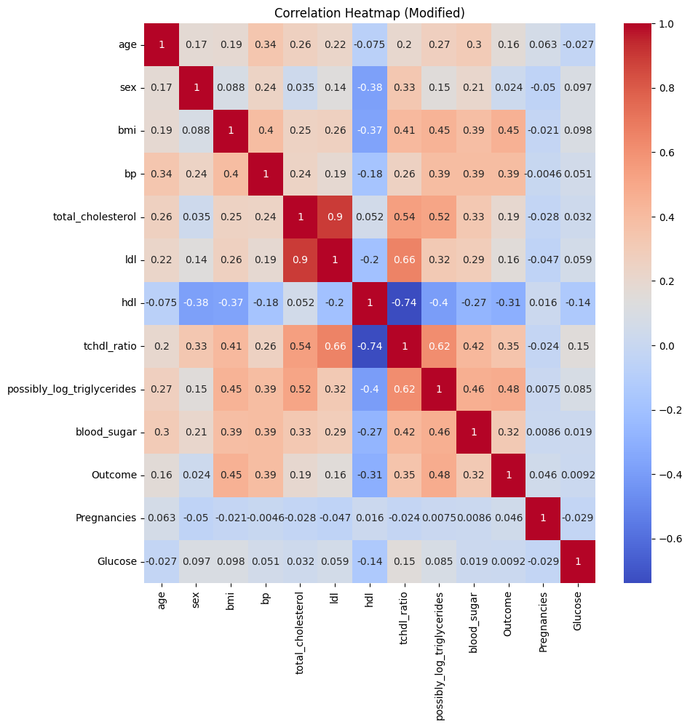
Pregnancies vs. Age (0.54): Older women tend to have more pregnancies.
Glucose vs. Outcome (0.47): Glucose levels have the strongest positive correlation with diabetes outcome → high glucose strongly indicates diabetes.
BMI vs. Outcome (0.29): Higher BMI is also associated with diabetes.
Insulin vs. SkinThickness (0.44): These two are correlated, since skin thickness is often linked with fat/insulin resistance.

Slide 9
Code For Diabaties Prediction
import pandas as pd
import numpy as np
from sklearn.datasets import load_diabetes
# load diabetes dataset from sklearn
diabetes = load_diabetes(as_frame=True)
dataset = diabetes.frame
# sklearn's diabetes dataset doesn't have "Outcome“
# so let's create a fake binary targetdataset["Outcome"] = np.where(dataset["target"] > dataset["target"].mean(), 1, 0)
# drop original target column to match your old code
dataset = dataset.drop("target", axis=1)
# rename some columns to match original diabetes.csv structure
# The dataset now has 11 columns (10 original features + 1 new 'Outcome’)
# The original diabetes dataset features are: age, sex, bmi, bp, s1, s2, s3, s4, s5, s6
dataset.columns = ['age', 'sex', 'bmi', 'bp', 'total_cholesterol', 'ldl', 'hdl', 'tchdl_ratio', 'possibly_log_triglycerides', 'blood_sugar', 'Outcome’].

Slide 10
# The original diabetes dataset features are: age, sex, bmi, bp, s1, s2, s3, s4, s5, s6
dataset.columns = ['age', 'sex', 'bmi', 'bp', 'total_cholesterol', 'ldl', 'hdl', 'tchdl_ratio', 'possibly_log_triglycerides', 'blood_sugar', 'Outcome']
import matplotlib.pyplot as plt
import seaborn as sns
import numpy as np
# Add dummy 'Pregnancies' and 'Glucose' columns for plotting purposes
# Replace this with actual data loading or generation if availabledataset['Pregnancies'] = np.random.randint(0, 15, size=len(dataset))dataset['Glucose'] = np.random.randint(50, 200, size=len(dataset))
# Pregnancies density plot
plt.figure(figsize=(10,10))
kd=sns.kdeplot(dataset['Pregnancies'][dataset["Outcome"]==1],color="Green",fill=True)
kd=sns.kdeplot(dataset['Pregnancies'][dataset["Outcome"]==0],color="Orange",fill=True)
kd.set_xlabel("Pregnancies")
kd.set_ylabel("Density")
kd.legend(["Positive","Negative"])
plt.title("Pregnancies Density Plot")

Slide 11
# Glucose density plotplt.figure(figsize=(10,10))
kd=sns.kdeplot(dataset['Glucose'][dataset["Outcome"]==1],color="Green",fill=True)
kd=sns.kdeplot(dataset['Glucose'][dataset["Outcome"]==0],color="Orange",fill=True
kd.set_xlabel("Glucose")
kd.set_ylabel("Density")
kd.legend(["Positive","Negative"])
plt.title("Glucose Density Plot")
plt.figure(figsize=(10,10))sns.heatmap(dataset.corr(), annot=True, cmap="coolwarm")
# changed from "YlGn" to "coolwarm“
plt.title("Correlation Heatmap (Modified)")
plt.show()

Slide 12
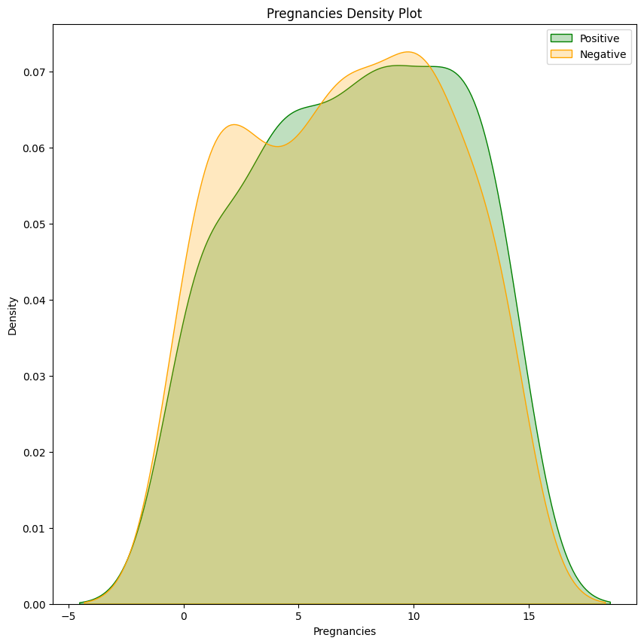

Slide 13
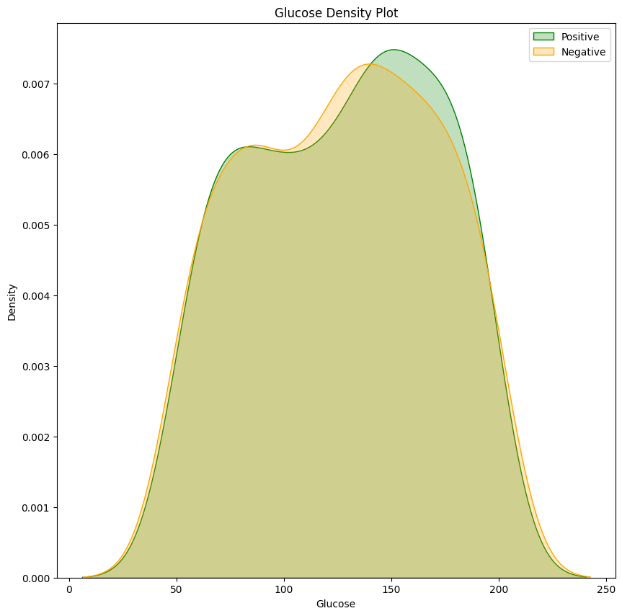

Slide 14
Challenges Faced
Imbalanced Dataset – fewer positive cases than negative.
Overfitting in some models.
Hyperparameter tuning needed for optimization.
Limited dataset size (768 samples).

Slide 15
Future Scope
Deploy as a web/mobile application.
Connect with wearable devices for real-time monitoring.
Use Deep Learning for better accuracy.
Apply Explainable AI (XAI) to interpret predictions.

Slide 16
Conclusion
Machine learning models can effectively predict diabetes.
Random Forest gave the best results in our case.
Early prediction can help in prevention & better treatment.

Slide 17
THANK YOU

